Slide 1
Passing the final checkpoint! NIST PQC 3rd round begins
Daniel Apon National Institute of Standards and Technology daniel.apon@nist.gov

Slide 2
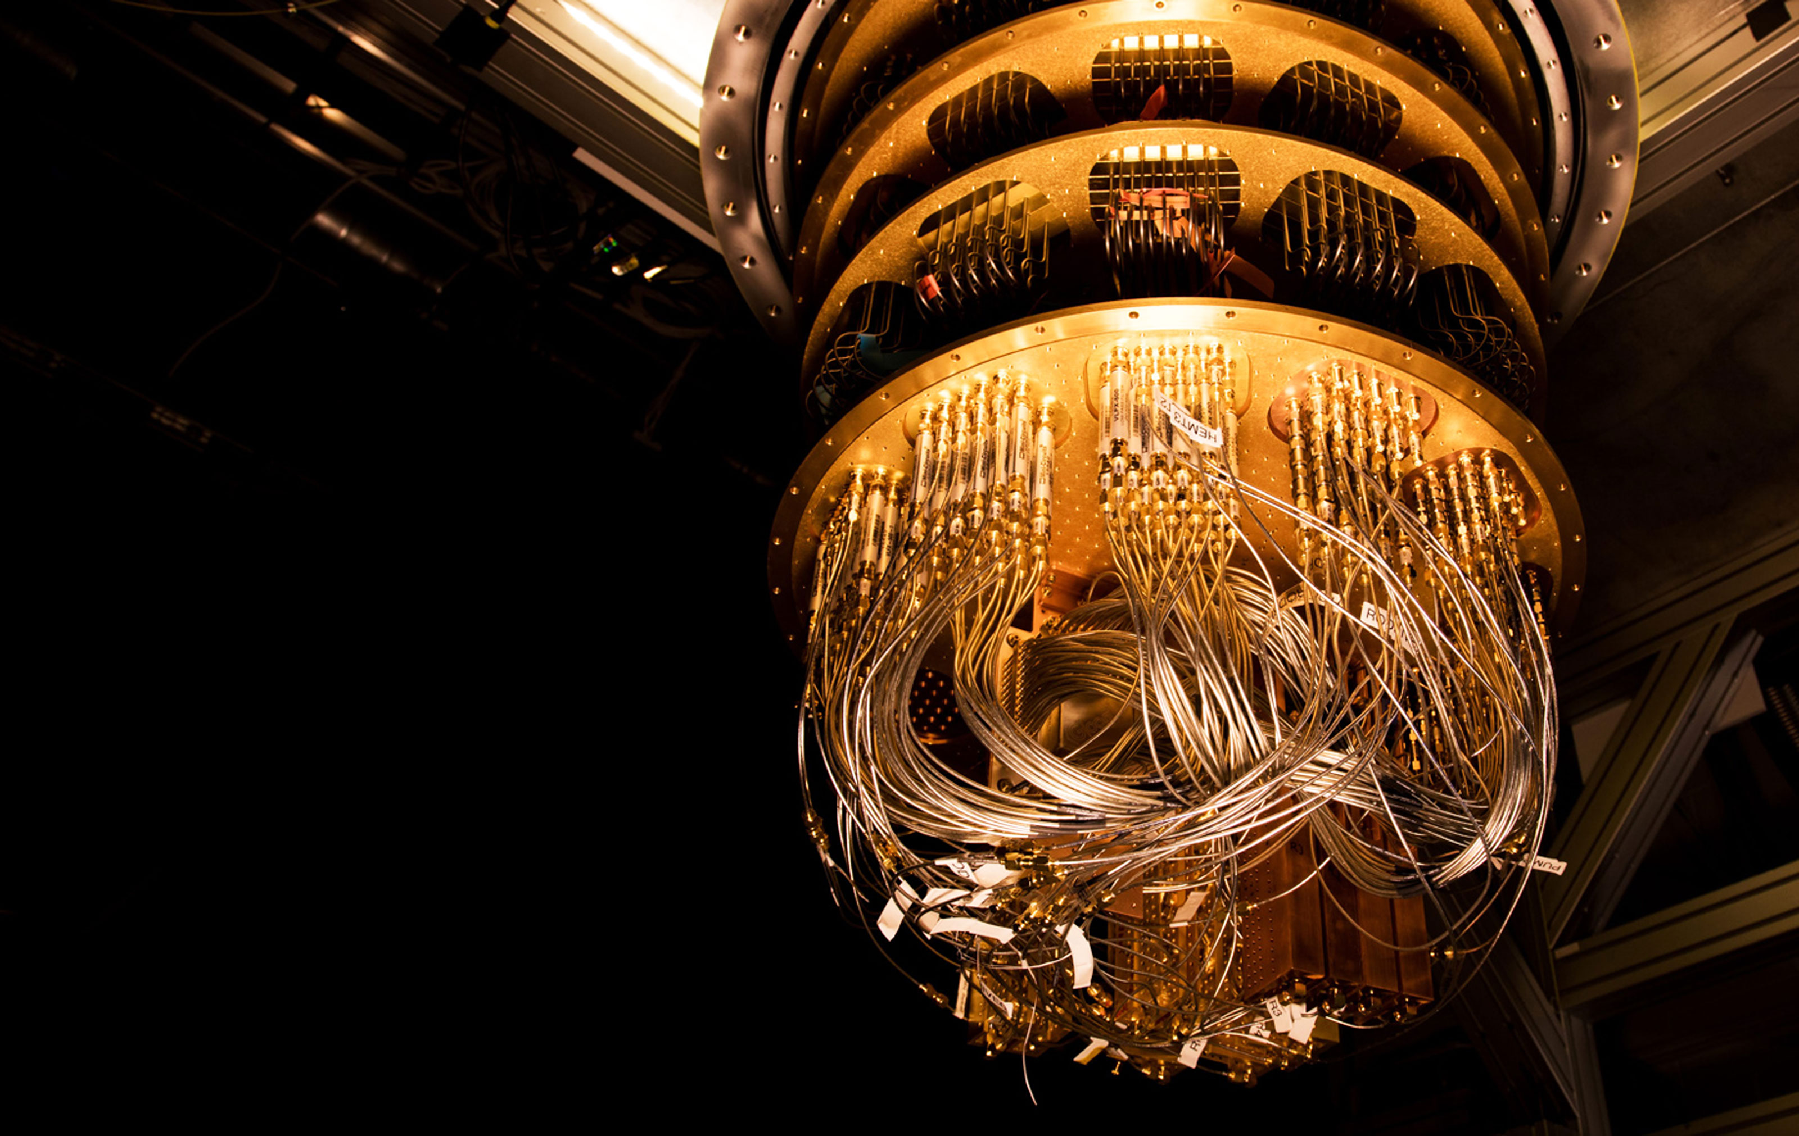
PQC, a haiku: Quantum algs coming!
RSA dead; Dlog too.
Help! What can we do?!

Slide 3
Where we’re at
Feb 2016 – NIST PQC “Competition” announced
Later in the year – submission requirements and evaluation criteria
Dec 2017 – 69 submissions accepted into 1st Round (5 withdraw)
Apr 2018 – 1st NIST PQC Standardization workshop
Jan 2019 – Round 2 candidates announced (17 KEM/PKE’s + 9 signatures)
Aug 2019 – 2nd NIST PQC Standardization workshop
July 2020 – Round 3 finalists announced (4 KEM + 3 Sig) plus 8 alternates
Aug 2020 – You are here (this talk)
≈ 2022-2024 – draft standards for public comment

Slide 4
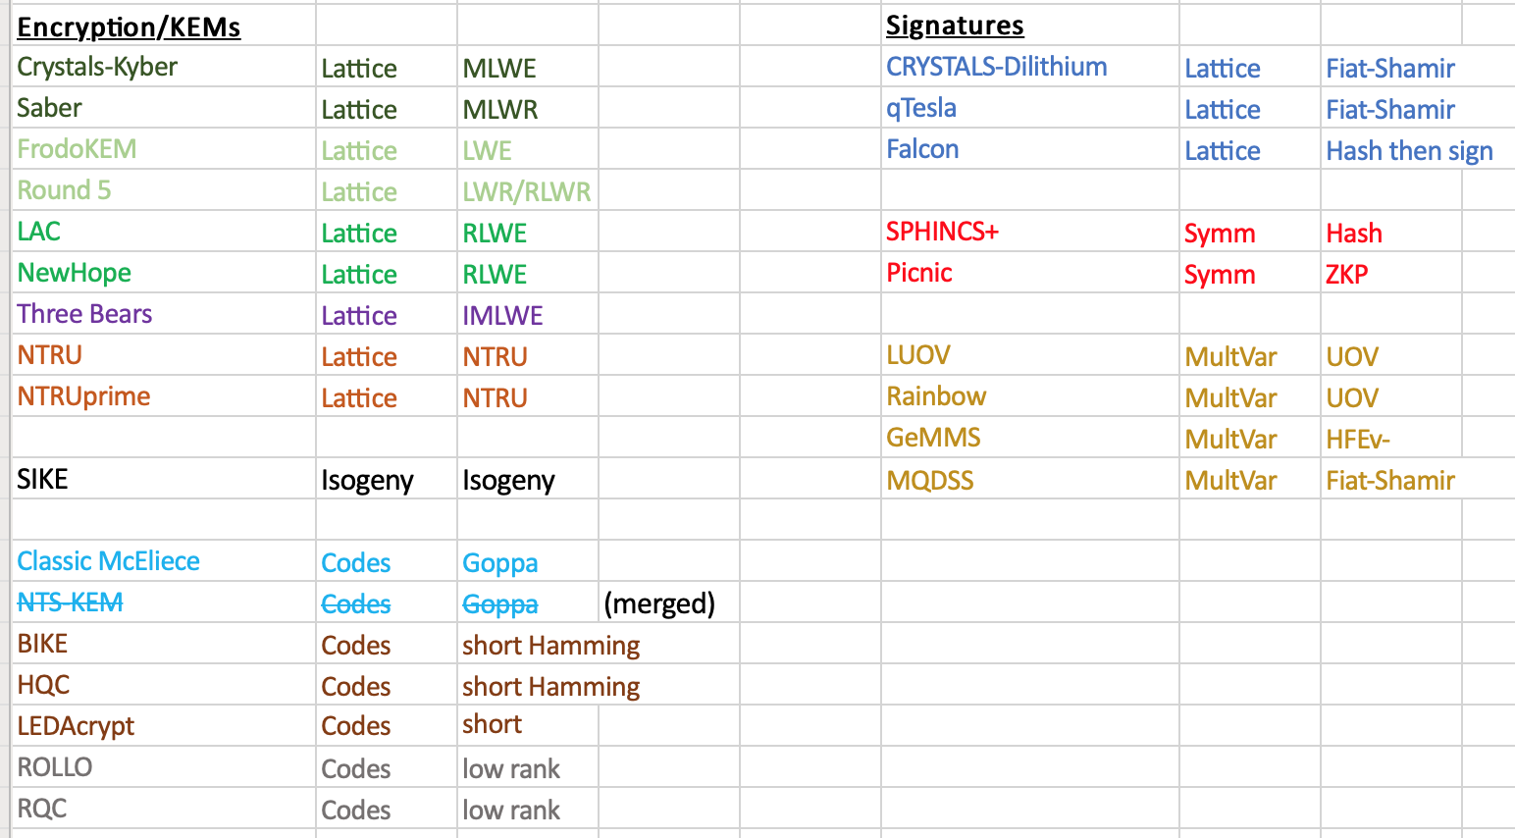
The 2nd Round candidates

Slide 5
The 2nd Round candidates.. and NIST’s selections
Eliminated in RED

Slide 6
The 2nd Round candidates.. and NIST’s selections
Eliminated in RED
Alternates in ORANGE
Finalists in GREEN

Slide 7
The 3rd Round – Finalists and Alternates
Finalist KEMs/PKEs
Kyber (MLWE lattice)
Saber (MLWR lattice)
NTRU (NTRU lattice)
Classic McEliece (Goppa Codes)
Alternate KEMs/PKEs
FrodoKEM (LWE lattice, unstructured)
NTRUprime (NTRU/RLWR lattice)
SIKE (Isogeny)
BIKE (short Hamming Codes)
HQC (short Hamming Codes)
Finalist Signatures
Dilithium (MLWE Fiat-Shamir)
Falcon (NTRU Hash-and-Sign)
Rainbow (UOV Multivariate)
Alternate Signatures
SPHINCS+ (hash-based)
Picnic (MPC-in-the-head ZKPoK)
GeMSS (HEv- Multivariate)

Slide 8
This talk
“Quick” survey of 2nd Round candidates
How the 3rd Round decisions were made (as I recall things a month later)
Open questions for the 3rd Round:
In terms of standards-selection decision-making…
What major issues need to be resolved w.r.t. the Alternates?
What major issues need to be resolved w.r.t. the Finalists?

Slide 9
Preamble: NIST PQC’s Evaluation Criteria
Security
Security levels offered
(confidence in) security proof
Any attacks
Classical/quantum complexity
Performance
Size of parameters
Efficiency of KeyGen, Enc/Dec, Sign/Verify
Software and Hardware
Decryption failures
Algorithm and implementation characteristics
Advantages and disadvantages
IP issues
Side channel resistance
Constant time code?
Simplicity and clarity of documentation
Flexible
Other
Round 2 changes
Official comments/pqc-forum discussion
Papers published/presented

Slide 10
Survey of 2nd Round Candidates
Focusing on the “lattice-like” schemes (time constraints)

Slide 11
PKE/KEM constructions
Broadly LWE-like
Product LWE
Main Variant (Frodo, Kyber, Saber, Three-Bears, LAC, NewHope, Round5, NTRU-LPRime, HQC, RQC)
Ouroboros variant (BIKE-3, ROLLO-III)
Quotient LWE (NTRU, sNTRUprime, BIKE-1/2 ,LEDAcrypt, ROLLO-I/II)
Other
Goppa codes (Classic McEliece, NTS-KEM)
Isogenies (SIKE)

Slide 12
Product LWE
KeyGen:
Generate random matrix/module/polynomial: $A$
and “short” matrix/module: $\left(\begin{matrix}r_{1} & r_{2}\end{matrix}\right)$
Public key components:
$$P_{1}=\left(\begin{matrix}r_{1} & r_{2}\end{matrix}\right) \left(\begin{matrix}A \\ I\end{matrix}\right)$$
$$P_{2}=A$$
Enc:
Generate “short” matrix/module: $\left(\begin{matrix}s_{1} \\ s_{2} \\ s_{3}\end{matrix}\right)$
Encode message noise tolerantly as $μ$
Ciphertext components:
$$\left(\begin{matrix}C_{1} \\ C_{2}\end{matrix}\right) = \left(\begin{matrix}I & 0 & P_{1} \\ 0 & I & P_{2}\end{matrix}\right)\left(\begin{matrix}s_{1}+μ \\ s_{2} \\ s_{3}\end{matrix}\right)$$
Dec:
Calculate
$$C_{1}−r_{1}C_{2}= μ+\left(\begin{matrix}I & {−r}_{1} & {−r}_{2}\end{matrix}\right)\left(\begin{matrix}s_{1} \\ s_{2} \\ s_{3}\end{matrix}\right)$$
Main variant:
Recover $μ$ using noise tolerant encoding/ public ECC
Ouroboros Variant:
Let $μ=0$
Instead Recover $\left(\begin{matrix}s_{1} \\ s_{2} \\ s_{3}\end{matrix}\right)$ Using:
MDPC decoder (BIKE-3)
LRPC decoder (ROLLO-III)

Slide 13
Quotient LWE
KeyGen:
Generate “short” matrix/module:
$$\left(\begin{matrix}r_{1} & r_{2}\end{matrix}\right)$$
Public key:
$$P=r_{1}^{−1}r_{2}$$
Enc:
Generate “short” matrix/module:
$$\left(\begin{matrix}s_{1} \\ s_{2}\end{matrix}\right)$$
Ciphertext:
$$C= \left(\begin{matrix}I & P\end{matrix}\right)\left(\begin{matrix}s_{1} \\ s_{2}\end{matrix}\right)$$
Dec:
Calculate
$$r_{1}C= \left(\begin{matrix}r_{1} & r_{2}\end{matrix}\right)\left(\begin{matrix}s_{1} \\ s_{2}\end{matrix}\right)$$
Recover $\left(\begin{matrix}s_{1} \\ s_{2}\end{matrix}\right)$ Using:
NTRU Trapdoor (NTRU, sNTRUprime)
MDPC decoder (BIKE-1,2, LEDAcrypt)
LRPC decoder (ROLLO-I, II)

Slide 14
Design Choices for Product/Quotient LWE
Metric
Noise Distribution
Ring/Module structure
Decoding

Slide 15
Metric
Euclidean (Frodo, Kyber, Saber, ThreeBears, LAC, NewHope, Round5, NTRU, NTRU-Prime)
Characteristic attack: Lattice reduction (LLL, BKZ, Sieving, Enumeration)
Hamming (BIKE, HQC, LEDAcrypt)
Characteristic attack: Information set decoding
Rank (RQC, ROLLO)
Characteristic attacks:
Combinatorial: Linear algebra search /support trapping
Algebraic (Minors, Kipnis-Shamir, Syndrome modeling)
NOTE: Dramatic recent improvement in algebraic attacks doubling parameter sizes

Slide 16
Noise Distribution
Fixed Weight (NTRU, sNTRUprime, BIKE, HQC, ROLLO, RQC, LAC)
Seems to protect against failure boosting attacks. How effectively?
For lattices, security proofs generally assume Gaussian noise. Is this distribution different enough to lead to problems?
Fixed Weight/Product structure (LEDAcrypt)
The product structure enables an attack!
Binomial (Frodo, Kyber, NewHope, ThreeBears)
Closer to Gaussian. Close enough?
Subject to failure boosting
Rounding (NTRU-LPRime, Round5, Saber)
No known reduction from LWE to LWR, but no known attacks on normal parameter ranges for LWR KEMs.
Subject to failure boosting
Unless there are no failures (NTRU-LPRime)

Slide 17
Ring/module structure
None (Frodo, Round5N1)
Larger PKE/CT for product LWE. Much larger public key for quotient (No submissions)
Ring (LAC, NewHope, Round5Nd, NTRU, NTRUprime, BIKE, HQC, LEDAcrypt, ROLLO, RQC – also qTesla, Falcon)
Needed to optimize bandwidth for Quotient LWE schemes, as well as Hamming and Rank Schemes
Module (Kyber, Saber, ThreeBears – also Dilithium)
For lattice product LWE, there is essentially no performance penalty for choosing module over ring
Is there security benefit to less structured lattice?

Slide 18
Which ring is the one ring to rule them all?
Power of 2 cyclotomic $ℤ_{q}\left[x\right]/\left\langle x^{2^{k}}+1\right\rangle$ (NewHope, LAC, Kyber, Saber – also Dilithium, qTesla, Falcon)
Enables fast multiplication for NTT (NewHope, Kyber)
Lattice search-decision reduction
Field (NTRUprime, ROLLO, RQC) $F_{q^{n}}$
Avoids attacks due to factoring polynomial modulus in Rank-based crypto
Is this property needed for lattices? Is it meaningful when modulus switching is possible?
Prime Quasicyclic $ℤ_{q}\left[x\right]/\left\langle x^{p}−1\right\rangle$ (NTRU, BIKE, HQC, LEDAcrypt, Round5ND)
Need to be careful of evaluation at 1 homomorphism
If you are, no apparent problems
Least factorizable choice for Hamming metric
Prime Cyclotomic $ℤ_{q}\left[x\right]/\left\langle {(x}^{p}−1)/(x−1)\right\rangle$(Round5ND)
Prime quasicyclic without the factor that allows evaluation at 1
Pseudo-Mersenne $ℤ_{2^{3120}−2^{1560} −1}$ (ThreeBears)
And now, for something completely different

Slide 19
Decoding (Principally relevant for cost of side channel resistance)
Regev or NTRU style rounding only (Frodo, Kyber, Saber, NTRU, NTRUPrime)
Repetition/Majority (NewHope)
XE5 (Round5)
Melas FEC (ThreeBears)
BCH (LAC, HQC)
Gabidulin (RQC)
LRPC decoder (ROLLO)
BitFlipping (BIKE, LEDAcrypt)
Note: recent issues with estimating DFR and achieving constant time. These are claimed fixed, but need to be vetted

Slide 20
Learning with Errors (and its variants)
Recall LWE:
random secret $s←𝒰(ℤ_{q}^{n})$
hard (search): find $s$ from samples $\left(a, \left\langle a | s\right\rangle +e\right)$ [where $a←{𝒰(ℤ}_{q}^{n})$ and $e←χ\left(ℤ_{q}\right)$];
hard (decision): distinguish above (i.e., LWE) samples from random (i.e., ${𝒰(ℤ}_{q}^{n+1})$) samples.
Matrix version (just a bunch of samples at once):
hard (decision): distinguish $(A, As+e$) from $\left(A, u\right)$ [for $A←{𝒰(ℤ}_{q}^{n×m})$, $s,u←{𝒰(ℤ}_{q}^{n})$, $e←χ\left(ℤ_{q}^{n}\right)$]
LWR (Learning with Rounding):
hard (decision): distinguish $(A, {\left\lfloor As\right\rfloor }_{p}$) from $\left(A,{\left\lfloor u\right\rfloor }_{p}\right)$
(Here ${\left\lfloor ⋅\right\rfloor }_{p}:ℤ_{q}→ℤ_{p}$ is the “obvious” map: output $log⁡(p)$ most significant bits of input.)
(Hardness follows from LWE even for polynomial $q$ so long as $q ≥ nmβp$).

Slide 21
Learning with Errors (and its variants)
Module-LWE:
define ring of polynomials $R_{q}=ℤ_{q}\left[X\right]/(X^{n}+1)$;
hard (decision): for a secret $s←𝒰\left(R_{q}^{k}\right)$, distinguish samples:
$(a, a^{⊺}s+e)$ where $a←𝒰\left(R_{q}^{k}\right)$ and $e←χ\left(R_{q}\right)$;
$\left(a, b\right)←𝒰\left(R_{q}^{k}×R_{q}\right)$.
hard (search): find $s$ from the samples.
(probably also hard if we sample $s$ via $χ$.)
So MLWE somehow “interpolates” between LWE and RLWE.
No attacks known that distinguish RLWE or MLWE from LWE.
In practice, $k$is constant.

Slide 22
Dilithium and qTesla (oh yeah, signatures..)
“Fiat-Shamir from lattices.”
Generate some MLWE keys: $(A, T≔AS+E)$
To sign a message $μ$, do:
sample a random $y$, compute $w=HighBits(Ay)$;
compute hash $c≔H(w, μ)$;
set $z≔y+Sc$;
output $(z, c)$.
To verify a signature $(z, c)$ of message $μ$:
Compute $w′=HighBits(Az−Tc)$;
Return $c==H\left(w^{′}, μ\right).$
Check: $Az−Tc=(Ay+ASc) −\left(ASc+Ec\right)=Ay−Ec$.
commit
challenge
Rejection sample to ensure
$z$ does not leak info about $S$
response
since we’re taking $HighBits$, verifier does not need to know all of $T$
give “hint” to help verifier get carries from $c$ times low-order bits of $T$
factor 2.5 savings in pk at a cost of 150-byte larger sigs

Slide 23
Security of LWE (generally)
Presumed security based on hardness of MLWE (vaguely, key recovery) and MSIS (vaguely, unforgeability.)
Some security proofs in (Q)ROM.
For attacks, essentially only idea:
ignore structure, treat as LWE;
turn your LWE into SVP instance (noisy equations $→$ basis for lattice);
solve that using your favorite SVP solver.
For this case, the parameters are set with some version of BKZ together with a classical/quantum SVP sieve for the reduced lattices.

Slide 24
Round 2 candidates not covered (wow, such time constraints on talk):
Falcon
SPHINCS+
MQDSS
PICNIC
Rainbow
GeMSS
Classic McEliece
SIKE

Slide 25
NIST’s decision process for Round 3

Slide 26
Reminder: The 2nd Round candidates

Slide 27
Attacked 2nd Round Candidates
LEDAcrypt
ROLLO
RQC
qTESLA
LUOV
MQDSS
Round5 and LAC

Slide 28
1) LEDAcrypt
Oct 2019 – Attack by Apon, Perlner, Robinson, Santini
“For 2^{49.22} AES-256 operations, we recover 1 in 2^{47.79} Category-5 keys”
“We think we can recover nearly all of the keys for LEDAcrypt (CPA, Category 5, $n_{0}=2$) for about $2^{240}$ classical AES operations”
“Our attack shows that LEDAcrypt’s product structure is a security problem not just asymptotically, but concretely”
LEDAcrypt team acknowledges.
Attempted to merge with BIKE, but it didn’t happen. Unlucky.

Slide 29
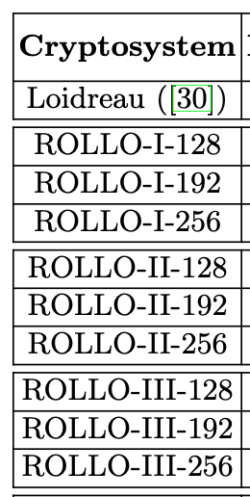
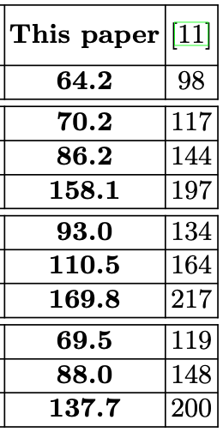
2) ROLLO
March 11, from Gaborit, Perlner, Smith-Tone, et. al.
Improves earlier attack paper from Gaborit, et. al.
“…our new attacks show that ROLLO parameters are broken and need to be changed.”
“Moreover, unlike that previous attack, the new one does not rely on Grobner basis computations and thus does not require any assumption concerning the behavior of the so-called solving degree. “
New parameters proposed – “with a loss of only about 50% in key size….”

Slide 30
3) RQC
From same paper as ROLLO
New proposed key sizes approximately double
“Overall the results proposed in this paper give a new and deeper under- standing of the complexity of difficult problems based on the rank metric. These problems have a strong interest since many systems still in the second round of the NIST standardization process, like ROLLO, RQC, GeMSS or Rainbow can be attacked through these problems. “

Slide 31
4) qTESLA
April 2019 comment by Vadim Lyubashevsky and Peter Schwabe
A “complete break” of qTESLA parameters for compressed public-keys (which had a security proof that was wrong)
They can sign messages faster than that qTESLA implementation w/o knowing the secret key
For their main (heuristic) parameters, “there is no reasoning…as to why their parameters have the concrete hardness of SIS they claim”
“provably secure” parameters still apparently okay (but much larger key sizes than Frodo)
qTESLA confirmed attack worked on compressed key version. Drops those parameter sets. They disagree about the rest.
Aug 2019 – qTESLA agrees with Vadim about security gap for the heuristic parameters. They drop those parameters sets, leaving only the provably secure version.

Slide 32
5) LUOV
June 2019 – Subfield differential attack by Ding, et. al.
Lowered security for level 2 from 147 bits to 107 and from 147 to 135
Lowered security for level 4 from 210 bits to 144.5 and from 214 to 202
Lowered security for level 5 from 272 bits to 184 and from 273 to 244.
Implemented it on level 2 parameter set and it worked
LUOV didn’t dispute, and proposed dropping lifting technique to use just UOV; we said no (unlucky).
In Sept, they gave new parameters (with prime degree extensions). About the same size and w/ same efficiency.
More recently, Ding, et al. (CRYPTO20 paper) showed how to forge a LUOV signature in 210 minutes of real-world computation (massive break)

Slide 33
6) MQDSS
Aug 2019 – Greg Zaverucha and Daniel Kales announce attack
“Concretely, forging a signature for the L1 instance of MQDSS, which should provide 128 bits of security, can be done in ≈ 2^95 hash function calls with high probability. We verify the validity of the attack by implementing it for round reduced versions of MQDSS, and show that we can forge a signature for 40 rounds of MQDSS with ≈ 2^29 hash function calls.
Even though a security proof of the scheme exists and we did not find a flaw in it, the proof is not tight enough to rule out these attacks. Our attack does not break the MQDSS design, rather the proposed parameter sets.”
MQDSS team confirms attack, proposes new parameters.
Need to have 1.4x more rounds. Security proof still valid (just not tight). Key sizes almost 50% bigger
This appears to make the scheme worse in performance than SPHINCS+…

Slide 34
7) Round5 and LAC
LAC has had attacks since Aug as well:
CCA attack using decryption failures
Attack on LAC in misuse situation
None outright break it, but LAC has
had to adjust parameters
Round5 had a minor attack announced in Aug 2019
Recent response: “Tighter concrete security analysis of small secret attacks. After having many discussions, the main conclusion is that the original security estimates hardly change, and thus, we are not suggesting any change of parameters.”
+ an improved implementation

Slide 35
Ok, let’s recap the decisions!

Slide 36
Schemes eliminated after Round 2 were..
Round 5 – “minor attack, but overly complicated spec to achieve the same”
LAC – “death by a thousand cuts;” NIST lost confidence in the design..
NewHope – ??
Three Bears – ??
LEDAcrypt – a major cryptanalytic “break;” no longer competitive
ROLLO – a major cryptanalytic “break;” no longer competitive
RQC – a major cryptanalytic “break;” no longer competitive
qTESLA – a major “misstep;” NIST lost confidence in the design..
LUOV – a supermassive black hole of a cryptanalytic break
MQDSS – a major cryptanalytic “break;” no longer competitive

Slide 37
NewHope (vs Kyber/MLWE, or Saber/MLWR)
NewHope remains a very strong scheme. But NIST had to make cuts, so we needed to resolve this RLWE vs MLWE/R issue somehow.
Peikert-Pipin – unusually high-quality reduction in practice; transforms power-of-2 cyclotomic RLWE to MLWE
With minor caveats, rank 2,3,4 MLWE is always at least as good as RLWE
Reductions the other direction are not tight
Chose MLWE over RLWE. Could have picked RLWE over MLWE, but we picked the scheme with (in our view) a 1% advantage in this case

Slide 38
Three Bears – O! my one truest love..
There doesn’t seem to be anything wrong with Three Bears.
It’s fast. It seems secure. It’s a great scheme. (Personally, I love it.)
No one seriously looked at it.. (Is it because it only had one author?)
To be as conservative/security-conscious as possible, we couldn’t move a scheme forward that hadn’t received a sufficient volume of external, third-party analysis (what if I am wrong?)
Alas, my love, fare thee well..

Slide 39
Finalists vs Alternates
We really promise we’re not putting the leftovers in the fridge to slowly rot…

Slide 40
The 3rd Round – Finalists and Alternates
Finalists KEMs/PKEs
Kyber (MLWE lattice)
Saber (MLWR lattice)
NTRU (NTRU lattice)
Classic McEliece (Goppa Codes)
Alternate KEMs/PKEs
FrodoKEM (LWE lattice, unstructured)
NTRUprime (NTRU/RLWR lattice)
SIKE (Isogeny)
BIKE (short Hamming Codes)
HQC (short Hamming Codes)
Finalist Signatures
Dilithium (MLWE Fiat-Shamir)
Falcon (NTRU Hash-and-Sign)
Rainbow (UOV Multivariate)
Alternate Signatures
SPHINCS+ (hash-based)
Picnic (MPC-in-the-head ZKPoK)
GeMSS (HEv- Multivariate)

Slide 41
The “first” scheme advanced to Finalist
Classic McEliece. Why?
Longest history, most “grey hairs” of any candidate.
Break standard Goppa Codes = win a Turing award, probably
What about the large public key?
PQ-Wireguard application paper really impressed us.
Amortize the large PK by including long-term key in software install package
Then, it has the smallest CTs (except SIKE) and fastest Enc/Dec of all
So, two categories of Finalists: “Amortize-PK” and “balanced/fast”

Slide 42
The “last” scheme advanced to Finalist
Rainbow. Why?
This is our “Amortized PK” signature Finalist.
PK is again very large, but especially Verify is the fastest (and can probably be sped up..). Also, the signature size is great! Best for secure boot applications?
Remaining concern: Ain’t nobody really sure about this multivariate stuff; MV has a bad rep. How confident can we be in MV security?
Cf. Perlner/Smith-Tone paper tightening known attacks against Rainbow; i.e. eprint 2020/702 “Rainbow Band Separation was Better than we Thought”

Slide 43
The other Finalists: It’s a lattice world, baby (Let’s jitter noisily into the future together!)
We promote both lattice signatures.
They’re the only “TLS-ready” options.
Among the lattice KEMs.. {Kyber, Saber, NTRU, NTRUprime, Frodo}
Frodo is the obvious backup as a “fall-out shelter,” in case the rest goes bad
They have very little to do with their scheme in the 3rd Round; e.g. check side-channels
Among the remaining, structured lattice schemes, our assessment was that cyclotomics (esp power-of-2 cyclotomics) are the clear “community standard”
So, we moved Kyber, Saber, NTRU on as Finalists, but kept NTRUprime too
More to say in the “open questions” shortly

Slide 44
About the other Alternates..
SIKE is a fantastic scheme, but its computation is by far the most expensive, and the problem is relative new. Who knows here?
BIKE & HQC are fantastic “balanced/fast” KEM options that, in particular, do not rely on a lattice-based computation assumption
We have a strong desire to standardize one of these two in the future..
GeMSS is an interesting “back-up” option to Rainbow. It’s based on a different type of multivariate assumption, could function as a “amortized PK” style of scheme. However, it’s noticeably bigger/slower than Rainbow.

Slide 45
And the last Alternates: SPHINCS+ and Picnic
SPHINCS+ is unusual as an Alternate; in the report, we made sure to point out “We might just standardize this at the end of the 3rd Round”
SPHINCS+ is incredibly stable, so we don’t think it needs additional focus atm
This is part of a generic strategy by the NIST PQC team: If a scheme is both stable in design and security is solid, but it may be out-performed by a different technology that is also seemingly stable and apparently secure against conjectured future adversaries, then we’ve moved it to Alternate.
Cf. Frodo.
Picnic we currently view as an “alternate” (little-a) to SPHINCS+
It requires an additional assumption (special LowMC security guarantee)
Picnic has improved performance in each round; will this happen again?

Slide 46
Major Questions for Round 3!
This is the good stuff =)

Slide 47
Major questions for Round 3 (there are many more..)
General questions
Side channel resistance? Hardware issues?
Ease of proper impl.?
IP issues?
CoreSVP vs real-world security: memory / machine modeling
Real-world transition (what do non-NIST groups say?)
Alternates
Can Picnic get faster? Is it safe?
Algebraic cryptanalysis of cyclotomics?
BIKE decoding analysis?
Finalists
Kyber vs. Saber vs. NTRU?
Dilithium vs Falcon?

Slide 48
Major questions for Round 3 (there are many more..)
General questions
Side channel resistance? Hardware issues?
Ease of proper impl.?
IP issues?
CoreSVP vs real-world security: memory / machine modeling
Real-world transition (what do non-NIST groups say?)
Alternates
Can Picnic get faster? Is it safe?
Algebraic cryptanalysis of cyclotomics?
BIKE decoding analysis?
Finalists
Kyber vs. Saber vs. NTRU?
Dilithium vs Falcon?
Here are five good issues to think about!

Slide 49
Open questions (each of these could be an entire talk..)
Side-channel resistance (welcome to the next two decades..)
BIKE decoding analysis (the great non-lattice hope)
Algebraic cryptanalysis of cyclotomics (..is it possible?)
CoreSVP vs real-world security (i.e. memory costing)
Real world PQC transition / non-NIST PQC (EU, China, Russia..)

Slide 50
1) Side-channel attacks on PQC
Notes:
CC = Classical Cryptanalysis STA = Static Timing Attack FA = Fault Attack SPA = Simple Power Analysis APA = Advanced (Correlation/Differential) Power Analysis EM = Electromagnetic Attack TA = Template Attack CB = Cold-Boot Attack CM = Countermeasures exist

Slide 51
1) Side-channel attacks on PQC
Not the complete picture!!
This was ~Jan 2020.
= new side-channel issues off the top of my head
SABER is the only team to claim a fully masked implementation!
Notes:
CC = Classical Cryptanalysis STA = Static Timing Attack FA = Fault Attack SPA = Simple Power Analysis APA = Advanced (Correlation/Differential) Power Analysis EM = Electromagnetic Attack TA = Template Attack CB = Cold-Boot Attack CM = Countermeasures exist

Slide 52
2) BIKE decoding analysis
BIKE’s scheme is design as a CPA-scheme, then a transform is performed to make it “CCA.” However, they only claim CPA security..
BIKE’s decoding algorithm isn’t properly analyzed yet.
It runs in rounds.
In each round, it gets closer to a proper decoding.
Proofs that Pr[decode] is high enough for CCA only exist with much more conservative parameters than BIKE’s current selection.
Although experimentally, it’s pretty good..
BIKE could claim CCA security if it had a stronger DFR analysis!
BIKE vs HQC.. (HQC is slow, has proper analysis; BIKE is fast, lacking analysis!)
Notes:
Parameter for BIKE to decode better: larger keys, less empirically efficient decoder, and/or infinite # of iterations

Slide 53
3) Algebraic attacks on cyclotomics?
Long history to give proper context:
GCHQ developed Soliloquy in 2007 (can be a KEM) on ideal lattices
GCHQ developed an efficient-ish quantum attack on Soliloquy (2010-2013)
In 2015, the underlying number theory and computational issues were discussed heavily on Google groups and blog posts
Turns out the attack also applies to Smart-Vercauteren’s FHE scheme from PKC ‘10 and Garg-Gentry-Halevi MMaps from Eurocrypt ’13
NTRU Prime’s field was first proposed as a defense against certain conjectured advances in this line of quantum algebraic cryptanalysis
Some work since.. but nothing threatening NTRU or Ring/Module-LWE yet.
Will we see new algebraic analysis making progress to an attack?

Slide 54
4) CoreSVP vs real-world security
The parameters that different lattice schemes present differ in their CoreSVP analysis.
Especially, at Category 1, some key examples:
NTRUprime: 129 CoreSVP (although they claim Category 2)
Saber: 125 bits (OK, that’s not enough.. or their analysis is incomplete!)
Kyber: 111 CoreSVP (Is this enough? Probably, but they need to argue it!)
Dilithium: 101 CoreSVP (Ok, this is definitely not enough.)
This issue is related to the attacker memory modeling; see pqc-forum!

Slide 55
5) Real-world PQC adoption
Will American/etc businesses adopt PQC? Maybe, hybrid PQC first?
ISO/IETF is explicitly waiting on NIST (note: stateful hash-based sigs)
ETSI has an ongoing effort, but which aims to complement NIST’s effort.
Countries explicitly waiting on NIST: Canada, UK, AUS, NZ, most of the EU countries, also South Korea, Japan, and many others..
The German govt already picked Frodo and Classic McEliece.
The Chinese govt picked LAC and another scheme eliminated in R1…
The Russians appear silent on how their standards (GOST) might evolve.

Slide 56
NIST PQC, a haiku: Submitted to NIST.
I’m perfect, invincible!
Eliminated..

Slide 57
Thanks!
Contact me at:
daniel.apon@nist.gov

Slide 58
Q&A Session: Taking all questions ☺
Finalist KEMs/PKEs
Kyber (MLWE lattice)
Saber (MLWR lattice)
NTRU (NTRU lattice)
Classic McEliece (Goppa Codes)
Alternate KEMs/PKEs
FrodoKEM (LWE lattice, unstructured)
NTRUprime (NTRU/RLWR lattice)
SIKE (Isogeny)
BIKE (short Hamming Codes)
HQC (short Hamming Codes)
Finalist Signatures
Dilithium (MLWE Fiat-Shamir)
Falcon (NTRU Hash-and-Sign)
Rainbow (UOV Multivariate)
Alternate Signatures
SPHINCS+ (hash-based)
Picnic (MPC-in-the-head ZKPoK)
GeMSS (HEv- Multivariate)

